Slide 1


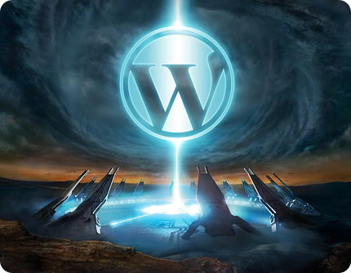
CMS Systems and WordPress
Content Management, Working with WordPress
Svetlin Nakov
Telerik Corporation
www.telerik.com

Slide 2
Table of Contents
Web Content Management Systems (CMS)
Joomla, Drupal, WordPress, SharePoint, …
Working with WordPress
Installing and Configuring
Administrative Interface: Pages, Posts, Categories, Tags, Comments, Settings
Themes
Plugins
Creating / Modifying WordPress Themes

Slide 3


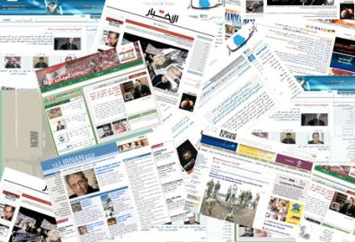
Web Content Management Systems (CMS Systems)
Overview

Slide 4
Web CMS Systems
Web Content Management Systems (CMS)
Software system providing Web site authoring, collaboration and administration tools
Users with little or no knowledge of HTML can create and manage Web sites content
CMS typical functions:
Create / maintain Web sites
Add / edit / delete pages, documents, news, images, files, forms, polls, events, blogs, …
Manage navigation, users, permissions, SEO, …

Slide 5
Benefits of CMS Systems
WYSIWYG editor
No need for advanced HTML or CSS skills
No need for Dreamweaver / FrontPage / etc. or Wiki syntax to learn
Can paste content from a word processor
Web-based access
Edit content from any computer
Staff can change content immediately
No waiting for Web admin to upload the content
Support for many types of documents and files

Slide 6






Examples of CMS Systems
Open Source CMS Systems
Joomla
Drupal
WordPress
DotNetNuke
Commercial CMS Systems
SharePoint (MOSS)
Telerik Sitefinity

Slide 7
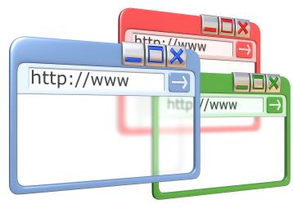

Web Content Management Systems (CMS Systems)
Live Demo

Slide 8
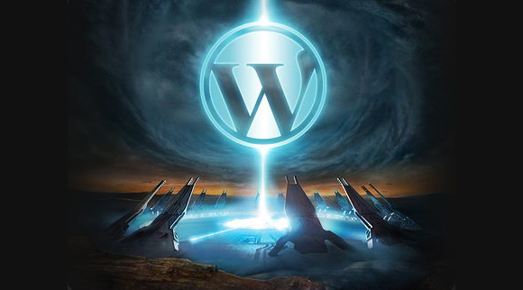
WordPress
Working with WordPress

Slide 9
What is WordPress?
WordPress is one of the world's leading blog and Web CMS systems
Open-source (free) software
Written with PHP and MySQL database
Stores all Web site contents in the database and images / files in the file system
Very powerful, Easy-to-use, SEO friendly
Very large community – themes, plugins, …
Official Web site: www.wordpress.org

Slide 10
Installing and Running WordPress
Installing WordPress
In the cloud (use WordPress as service)
Just create and account at www.wordpress.com
At your Web hosting provider
Download it (e.g. wordpress-3.2.1.zip)
Unzip it in some public directory at the server
Create the database and run the install script
Self-hosted
Install XAMP + WordPress at your local machine
XAMP = Windows + Apache + MySQL + PHP

Slide 11
WordPress Dashboard
The WordPress Dashboard is:
The administrative interface of WordPress
Create / edit / delete pages, posts, categories, tags, comments, documents, images, files, …
Manage users, themes, widgets, plugins, settings, …
User-friendly UI
WYSIWYG editor
Media library

Slide 12

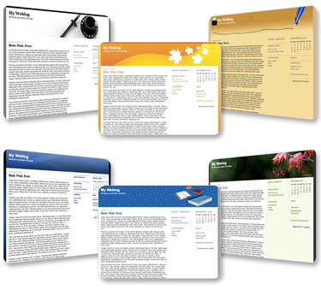
WordPress Themes
Using / Creating / Modifying WordPress Themes

Slide 13
WordPress Themes
WordPress supports themes
Themes define the structure, layout (the UI)
Can support or not widgets and menus
Can be single column / multi-column
Can be free or paid
The best themes are usually free
Users can switch between the installed themes
Official WordPress themes directory:
http://wordpress.org/extend/themes/

Slide 14
Custom WordPress Themes
Typical WordPress themes consist of
Main index template – index.php
Page template – page.php
Header – header.php
Footer – foorter.php
Sidebar – sidebar.php
Comments template – comments.php
Styles – styles.css
Theme functions – styles.css

Slide 15
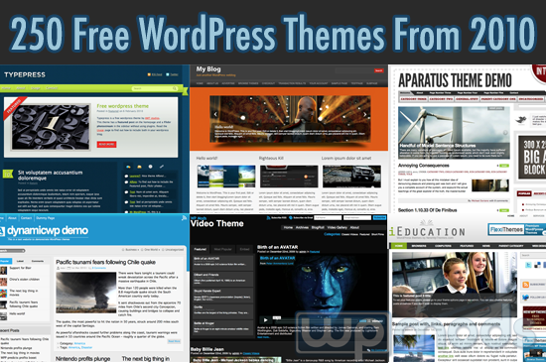

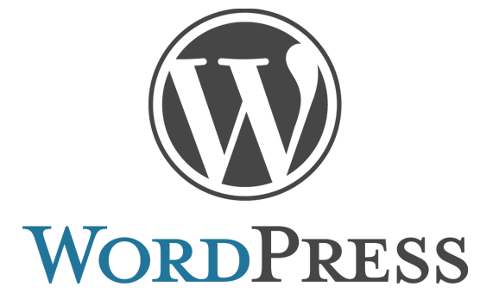
Using / Creating / Modifying WordPress Themes
Live Demo

Slide 16
CMS Systems and WordPress
?
?
?
?
?
Questions?
?
?
?
?
?
?

